Slide 1
Forget Me Not Team Meeting #5
Cassady, Gardone, Suter

Slide 2
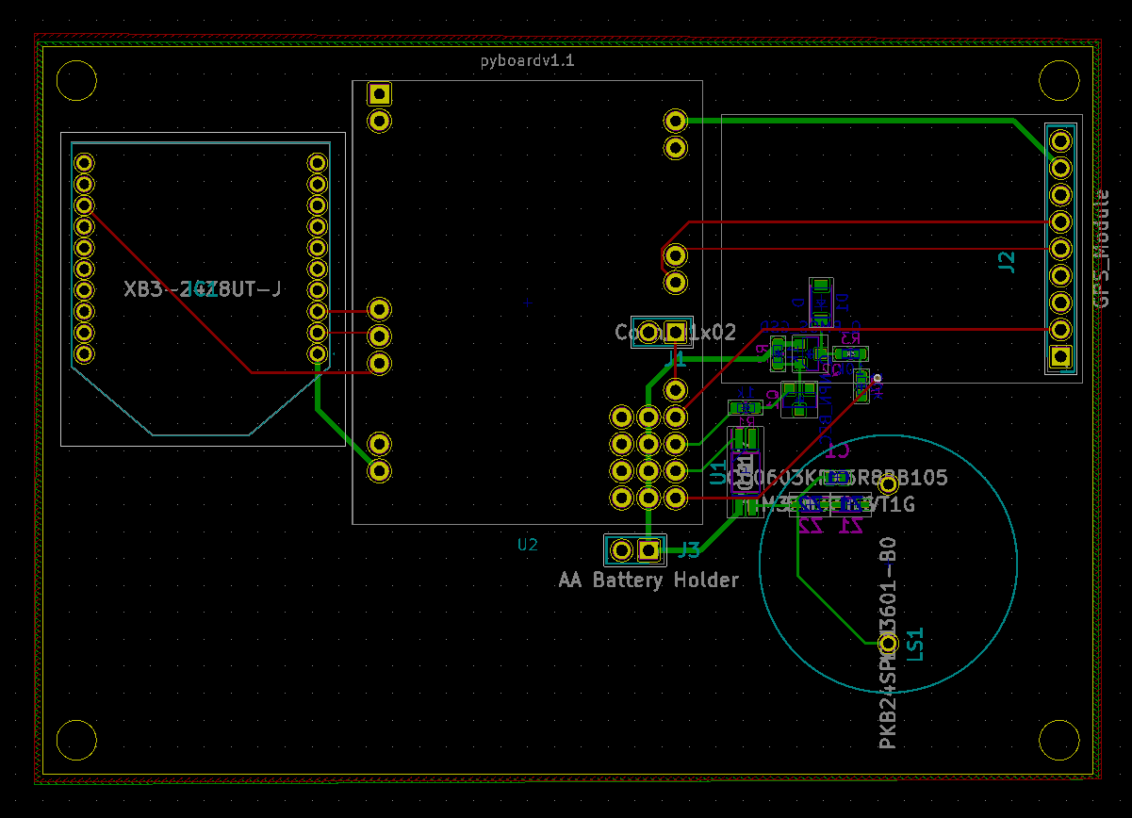
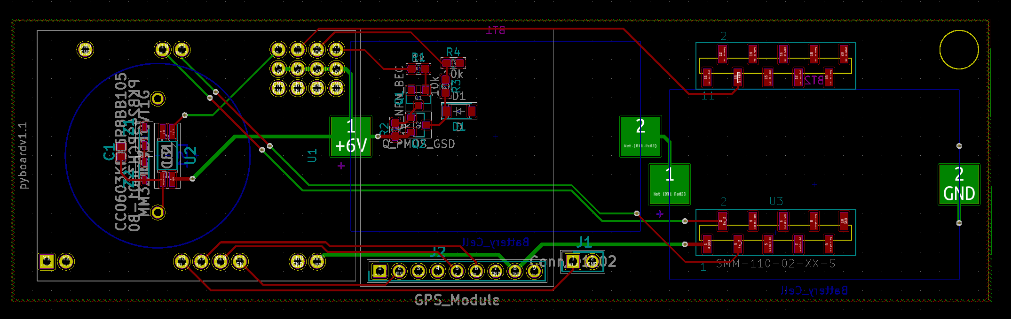
PCB Progress
Car Seat Subsystem Part Placement Finished
Schematic Finished
Suggestions for websites to order through?
OSH Park
SeeedStudio

Slide 3
Software Progress
XBee Explorer Module purchased to connect XBees to XCTU configuration software
Updated firmware on both modules.
Confirmed each module is working.
Began using PyBoard 1v1
Completed hello world with PyBoard 1v1 LEDs
Struggled to create UART connection with XBee
No errors produced when scripting. No errors returned when running program.
Attempted to use multiple UART ports on PyBoard
Will isolate issue by testing Raspberry Pi’s connection to XBee as well as test PyBoard 1v1’s UART connection with GPS.

Slide 4
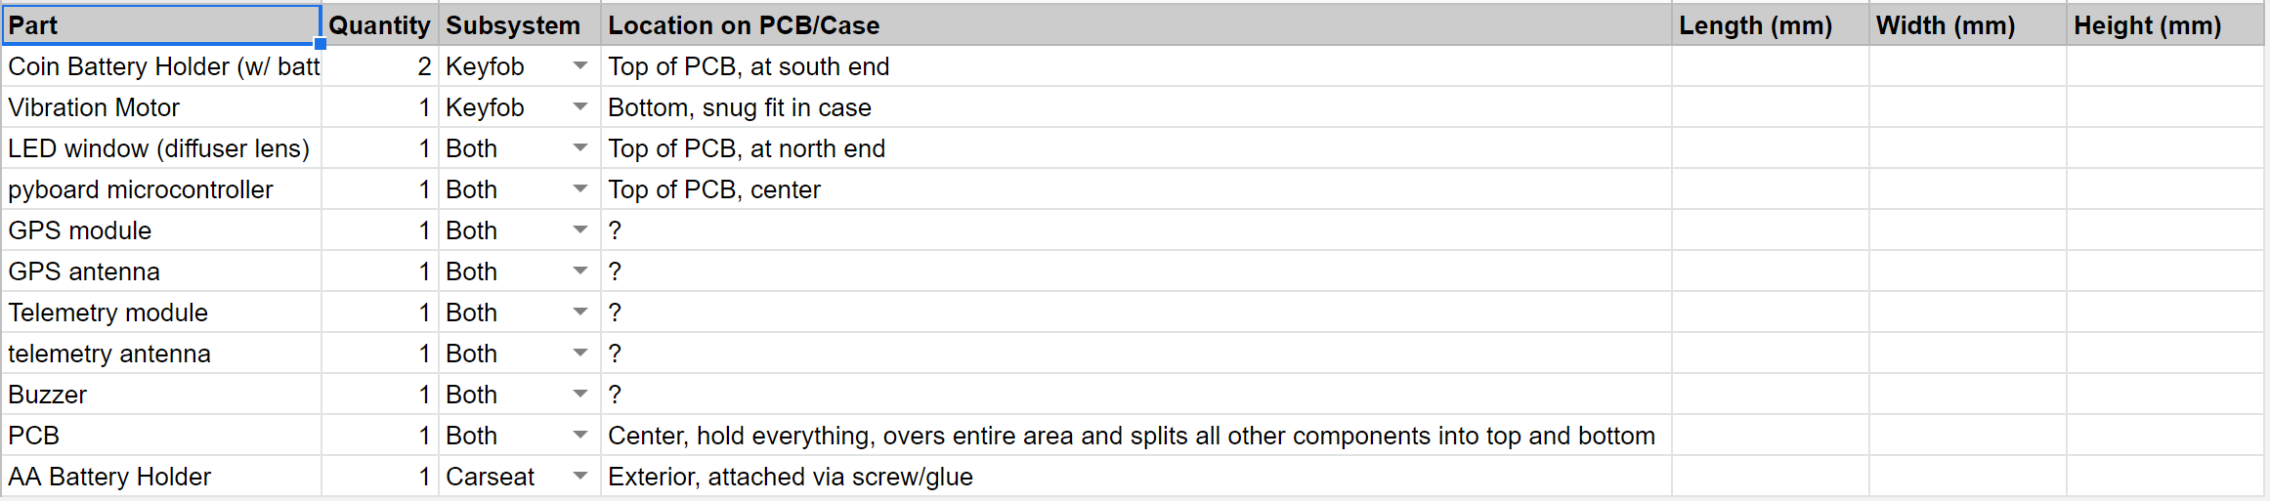
Casing Design Progress
Awaiting completion of PCB
Sheet detailing critical dimensions of large components put together. (Not fully populated)
Used for external dimensions of casing
Design concept written up.

Slide 5
Plans
Route traces on PCB
Practice with 3D printer - talk to Mr. Rockey
Design and Print car seat subsystem case
Create PCB layout of parts for keyfob subsystem
Continue to isolate issue with XBee modules.
Issues
Size requirement will be broken because of the power requirement.
Brainstorming ideas to “remarket” device from “keyfob” when present to sponsor.

